Slide 6
I2C Board of LCD Arduino
GND <---> GND
VCC <---> 5V
SDA <---> A4
SCL <---> A5

Slide 7
I2C Board of LCD Arduino
GND <---> GND
VCC <---> 5V
SDA <---> A4
SCL <---> A5

Slide 8
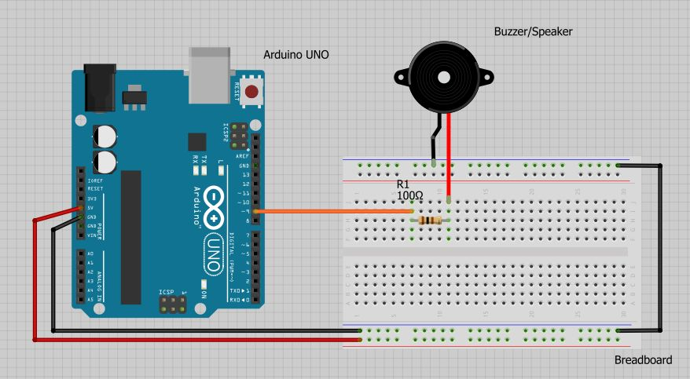

Slide 10
MICROSD CARD ADAPTER PIN | ARDUINO UNO PIN
CS | 4 or 10
SCK | 13
MOSI | 11
MISO | 12
VCC | 5V
GND | GND

Slide 11
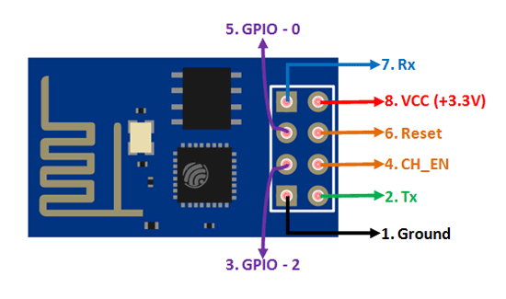

Slide 12
